Slide 1
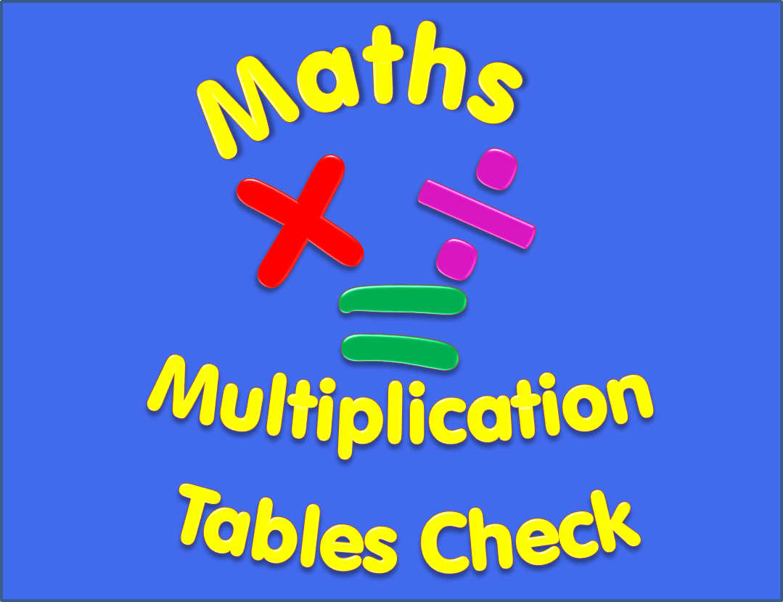

Slide 2
Begin
Instructions
There are 25 multiplication questions on any times table from 2 to 12.
Each multiplication question will appear on the screen for 6 seconds. There will then be a 3 second break before the next question appears.
Good Luck!

Slide 3
7 x 10
Q1

Slide 4
7 x 3
Q2

Slide 5
2 x 8
Q3

Slide 6
3 x 10
Q4

Slide 7
11 x 5
Q5

Slide 8
11 x 9
Q6

Slide 9
9 x 10
Q7

Slide 10
6 x 8
Q8

Slide 11
8 x 3
Q9

Slide 12
9 x 7
Q10

Slide 13
10 x 2
Q11

Slide 14
6 x 3
Q12

Slide 15
5 x 9
Q13

Slide 16
4 x 6
Q14

Slide 17
12 x 9
Q15

Slide 18
7 x 8
Q16

Slide 19
2 x 3
Q17

Slide 20
4 x 3
Q18

Slide 21
12 x 10
Q19

Slide 22
12 x 12
Q20

Slide 23
7 x 5
Q21

Slide 24
12 x 2
Q22

Slide 25
4 x 10
Q23

Slide 26
8 x 12
Q24

Slide 27
8 x 6
Q25

Slide 28
Completed!
All multiplication questions have now been shown.
To find out your score click on the button below.
Answers

Slide 29
Answers
1) 7 x 10 = 70 2) 7 x 3 = 21 3) 2 x 8 = 16
4) 3 x 10 = 30 5) 11 x 5 = 55 6) 11 x 9 = 99
7) 9 x 10 = 90 8) 6 x 8 = 48 9) 8 x 3 = 24
10) 9 x 7 = 63 11) 10 x 2 = 20 12) 6 x 3 = 18
13) 5 x 9 = 45 14) 4 x 6 = 24 15) 12 x 9= 108
16) 7 x 8 = 56 17) 2 x 3 = 6 18) 4 x 3 = 12
19) 12 x 10 = 120 20) 12 x 12 = 144 21) 7 x 5 = 35
22) 12 x 2 = 24 23) 4 x 10 = 40 24) 8 x 12 = 96
25) 8 x 6 = 48

